Slide 1
MANAGEMENT INFORMATION SYSTEMS
Chapter 4: Ethical and Social Issues in Information Systems

Slide 2
Recap of Chapter 3
What are the technical and behavioral views of organizations?
How do features of an organization affect information systems, and how do information systems affect organizations?
What is Porter’s Competitive Forces Model and the Value Chain Model?
Explain synergies, core competencies, and network economics.
How can AI be used in competitive strategies?
What are challenges posed by strategic information systems?

Slide 3
Ethics and Information Systems

Slide 4
Ethics and Information Systems
Ethics refer to the principles of right and wrong that individuals, acting as free moral agents, use to make choices to guide their behaviors.
Historically, major inventions raised ethical challenges:
Printing Press: Democratized knowledge but raised concerns about censorship of radical ideas.
Industrial Revolution: Drove economic growth but raised concerns about worker exploitation.
Nuclear Technology: Provided a new source of energy but raised ethical debates about weaponization.
The advent of powerful information systems presents similar dilemmas:
IS enables businesses to operate more efficiently than ever.
IS disrupts existing distributions of power and accelerates social change.
Like past technologies, IS offers great benefits while raising profound ethical questions

Slide 5
Ethics and Information Systems
Today’s IS-related concerns raised by the developments:
Internet and digital platforms
Artificial Intelligence and automation
Customer data use and privacy
Intellectual property protection
Key questions include:
How can we safeguard system quality to protect individuals and society?
How can we ensure accountability for IS consequences?
How can we preserve social values and institutions in the digital age?
Central Question: “What is the ethical and socially responsible course of action?”

Slide 6
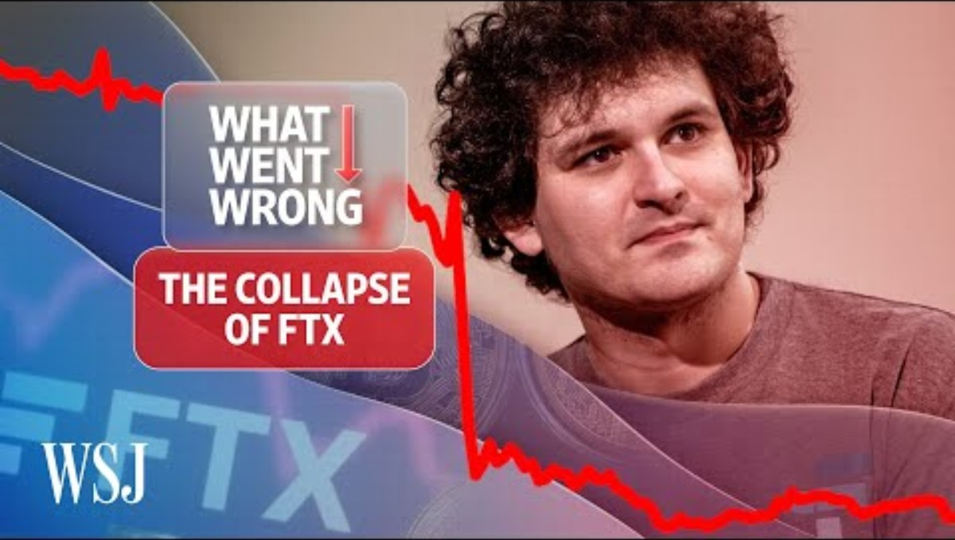
The Wall Street Journal (2022, November 14). The FTX Collapse, Explained | WSJ What Went Wrong [Video]. YouTube. https://youtu.be/AbgRB3arCpY?si=5sgEnw3jCOd-HSpl

Slide 7
Ethical Challenges in Conducting Business
Organizations face numerous ethical challenges in conducting business.
Recent years have seen high-profile failures in ethical judgment across many industries.
Fintech: Terra/Luna Collapse, FTX Collapse (2022)
Aviation: Boeing 737 Max Crisis (2019-2020)
Health: Theranos (2015-2022)
Automobile: Volkswagen’s “Dieselgate” (2015)
Failures in ethical business judgment are rarely masterminded by IS staff, but IS often enables misconduct:
IS can be used to conceal or disguise actions (Volkswagen, 2015)
IS can also help bury evidence from public scrutiny (Uber’s data breach cover-up, 2017)

Slide 8
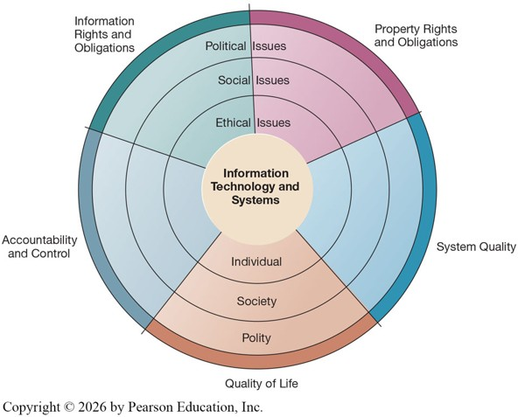
A Model for Ethical, Social, and Political Issues
Ethical, social, and political issues are closely linked.
Ethical dilemmas in IS often become social and political debates.
Model:
Society can be thought of as a calm pond in equilibrium.
Social institutions such as family, education, organizations, provide rules of behavior.
Political institutions (laws and sanctions) enforce rules and norms.

Slide 9
A Model for Ethical, Social, and Political Issues
New information technologies act as a shock to the system (like tossing a rock in a calm pond).
Consequences:
Old rules may not apply to new situations.
Social institutions take time to develop new norms.
Political institutions need time (and evidence of harm) to create new laws.
In the meantime, managers and firms may need to act in legal gray areas.

Slide 10
“Rocks in a Pond”
Social Media Platforms
Individual: Impacts on mental health, identity, and self-expression.
Social: Transformed how news spreads; fueled rise of influencers and new cultural norms.
Political: Concerns about election interference, national security, and content moderation.
Facial Recognition Technology
Individual: Concerns about constant surveillance and loss of privacy.
Social: Debates about fairness, bias, and discrimination in AI systems.
Political: Some cities/states banning or restricting government use.
New technologies act as rocks in a pond:
Creating ripples at the individual, social, and political levels that often outpace existing rules.
These ripples often highlight recurring areas of ethical concern, which we can group into five moral dimensions.

Slide 11
Five Moral Dimensions of the Information Age
Information Rights and Obligations:
What rights do individuals and organizations have regarding information?
What can these rights protect?
Property Rights and Obligations:
How do we protect intellectual property in a digital society?
Tracking and accounting for ownership is difficult while ignoring such property rights is easy.
System Quality:
What standards ensure safety and protect individual rights?
Accountability and Control:
Who is accountable and liable for harm caused by IS?

Slide 12
Five Moral Dimensions of the Information Age
Quality of Life:
What values and institutions should be preserved in an information society?
Which cultural values and practices does information technology support?
We examine each of these dimensions later in this chapter.
These dimensions become especially pressing as emerging IT trends intensify these ethical challenges.

Slide 13
Key IT Trends that Raise Ethical Issues
Ethical issues predate IT, but technology has intensified concerns.
Five major trends drive most of the ethical stress.
Increasing Computing Power
Computing power now central to core production processes.
Dependence on IS has grown, leading to increased vulnerability to errors and poor data quality.
Advances in Data Storage
Falling storage costs enable massive data collection on individuals.
Routine violations of privacy are inexpensive and effective.

Slide 14
Key IT Trends that Raise Ethical Issues
Advances in Data Analysis
Tools allow firms to combine and mine disparate data sources.
Enables profiling, the assembly of digital dossiers of individuals.
Advances in Networking & Mobility
Internet and mobile devices allowed easy access to massive data pools.
Privacy invasion possible on an unprecedented scale.
Artificial Intelligence
Increasingly used to substitute for human judgment.
Ignores human empathy and moral reasoning.
Raises issues for privacy and intellectual property rights.

Slide 15
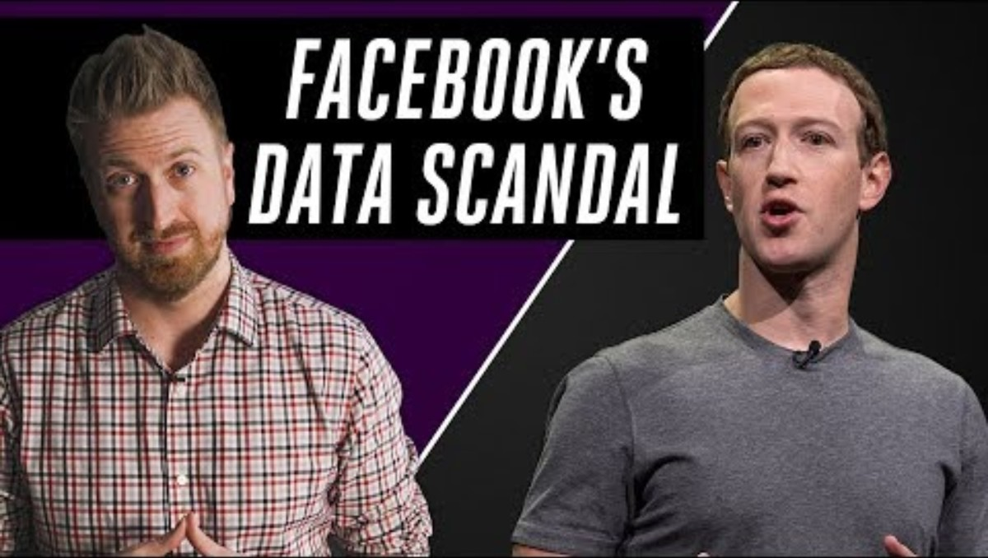
The Verge (2018, March 22). Facebook's Cambridge Analytica data scandal, explained [Video]. YouTube. https://youtu.be/VDR8qGmyEQg?si=3Es4Xg8gXHEXxPwo

Slide 16
Cambridge Analytica Case
Advances in Data Storage:
Facebook stored vast amounts of user data, and Cambridge Analytica was able to exploit loopholes to collect information on tens of millions of users.
Cheap, large-scale storage makes mass data collection easy, and when mishandled, it can turn into a serious privacy violation.
Computing Power / Data Analysis / Networking & Mobility
Cambridge Analytica used psychographic profiling, analyzing likes and behaviors to infer political attitudes and target individuals with tailored messages.
The scandal spread globally because Facebook’s platform is interconnected and mobile-accessible, allowing microtargeted political ads to reach users across borders.

Slide 17
Principles for Ethical Conduct

Slide 18
Basic Concepts
Ethics is about individual choice: “When faced with alternatives, what is the correct moral action?”
Ethical analysis relies on four key concepts:
Responsibility: Accepting potential costs, duties, and obligations for your decisions.
Accountability: Mechanisms exist to determine who acted and who is responsible.
Liability: Legal systems allow individuals to recover damages caused by others.
Due Process: Laws are known, understood, and fairly applied with the right to appeal.
Systems do not have impacts by themselves, but through the people who use them.
Users of IS can be held accountable for outcomes.
Others can seek legal remedies when harmed.
Try out: https://www.moralmachine.net/

Slide 19
The Moral Machine Experiment
Self-driving cars highlight how emerging technologies challenge traditional concepts of responsibility, accountability, liability, and due process.
Responsibility: Accepting potential costs, duties, and obligations for your decisions.
Who is responsible for the car’s decisions? The passenger, the manufacturer, or the programmer?
Accountability: Mechanisms exist to determine who acted and who is responsible.
Systems must track and record decisions (e.g., sensor data, algorithms) to determine who acted.
Liability: Legal systems allow individuals to recover damages caused by others.
If harm occurs, who pays damages? The automaker, software developer, or human occupant?
Due Process: Laws are known, understood, and fairly applied with the right to appeal.
Legal systems must establish clear rules and allow appeals to ensure fairness.

Slide 20
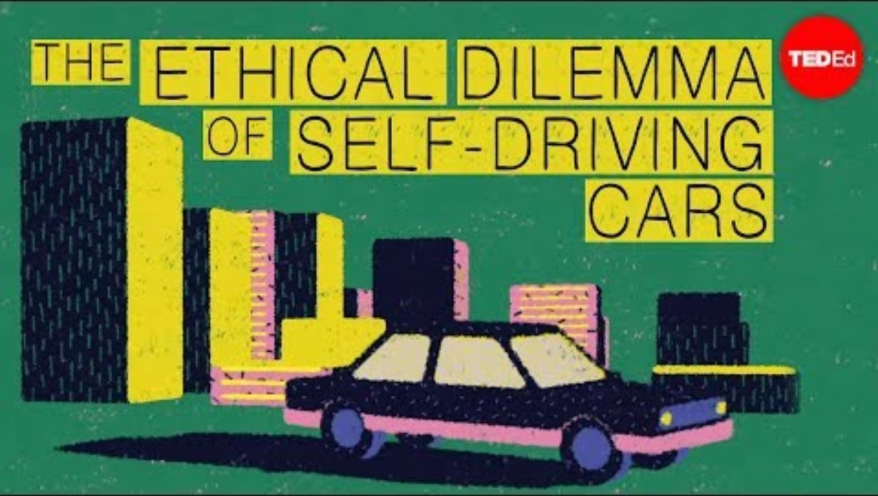
TED-Ed (2015, December 8). The ethical dilemma of self-driving cars – Patrick Lin [Video]. YouTube. https://youtu.be/ixIoDYVfKA0?si=SuJPlF1rE2aWaaOj

Slide 21
Ethical Analysis: The Five-Step Process
Identify and describe the facts clearly.
Find out who did what to whom and where, when, and how.
Define the conflict or dilemma and the higher-order values involved.
What are the competing values? (e.g. Efficiency vs. Privacy)
Identify the stakeholders.
Who has a stake? What do they want?
Identify the options available.
What courses of action are realistic?
Identify the potential consequences of each option.
What happens short-term and long-term if you choose this option?

Slide 22
Ethical Analysis: Hypothetical Case-Study
Case:
A large retail company provides employees with wearable fitness trackers to encourage healthy habits. The company says the program is voluntary and offers discounts on health insurance premiums for employees who meet fitness goals. Later, employees discover that the company is also using this data to evaluate worker productivity and make decisions about promotions and scheduling.
Identify and describe the facts clearly.
Define the conflict or dilemma and the higher-order values involved.
Identify the stakeholders.
Identify the options available.
Identify the potential consequences of each option.

Slide 23
Ethical Analysis: Hypothetical Case-Study
Facts
Company provides fitness trackers, claims voluntary use.
Data used for insurance discounts and performance evaluation.
Conflict/Dilemma
Health promotion vs. employee privacy and autonomy.
Efficiency/profit vs. fairness/transparency.
Stakeholders
Employees (privacy, fairness, career opportunities).
Employer/management (productivity, costs, reputation).
Insurance providers (risk reduction).
Customers/society (corporate responsibility).

Slide 24
Ethical Analysis: Hypothetical Case-Study
Options
Continue current practice.
Use data only for health incentives, not productivity.
Make program fully transparent and opt-in with explicit consent.
Stop using trackers altogether.
Consequences
Current practice: efficiency gains, but employee mistrust/ethical violations.
Health-only use: retains benefits, reduces ethical concerns.
Transparency/opt-in: builds trust, but may reduce participation.
End program: privacy preserved, but health incentives lost.

Slide 25
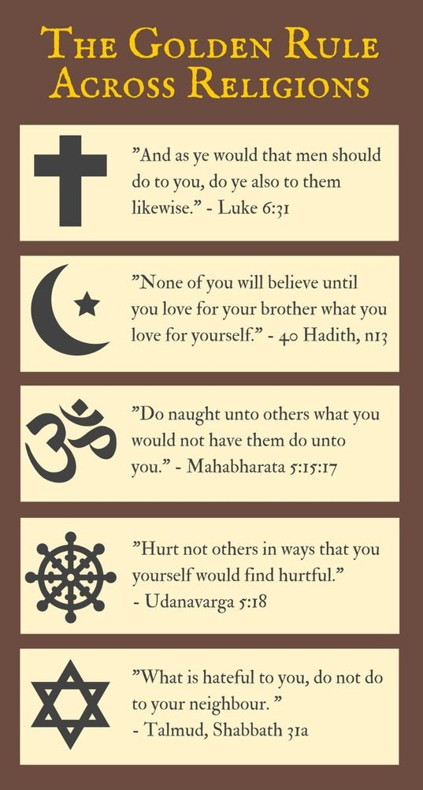
Ethical Principles: The Golden Rule
The Golden Rule
“Do unto others as you would have them do unto you.”
Matthew 7:12
“Do not impose on others what you yourself do not desire.”
The Analects 15:24
Found across cultures and religions throughout history.
Modern Extension: The Platinum Rule
“Treat others the way they would like to be treated.”
Moves from empathy to personalization.

Slide 26
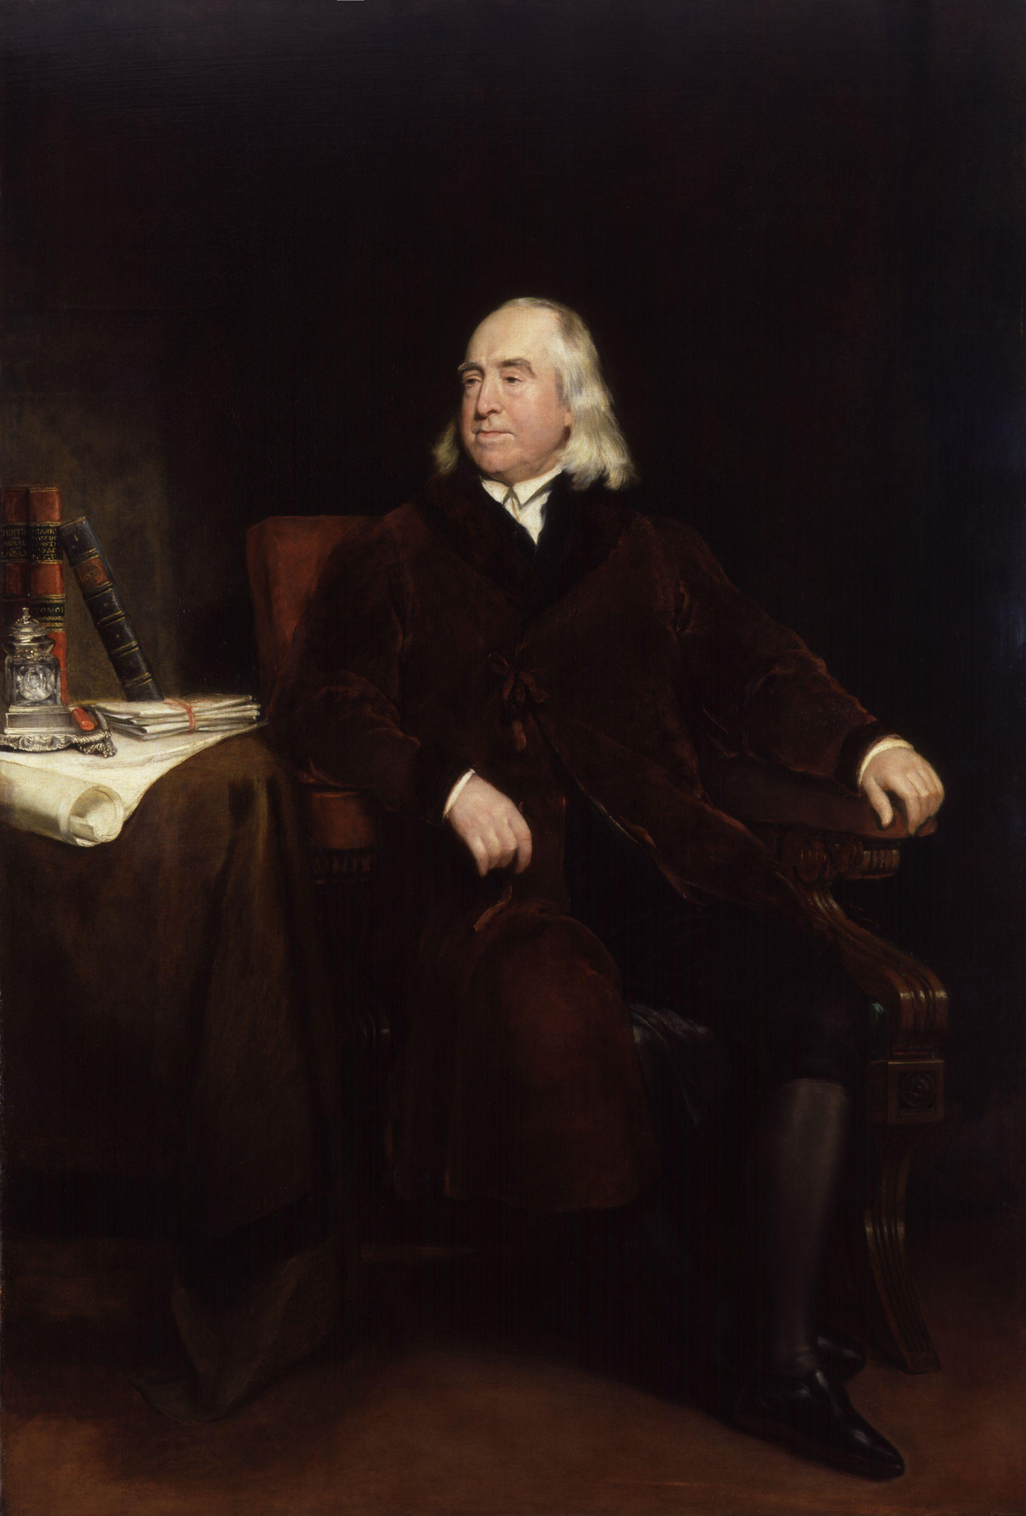
Ethical Principles: Jeremy Bentham
Jeremy Bentham’s Utilitarianism
“It is the greatest happiness of the greatest number that is the measure of right and wrong.”
Radical for the time, when the needs of the royals and nobles superseded the needs of the common folk.
Raises some questions:
How do we compare “happiness” across different people?
If one person’s suffering can lead to a small amount of happiness for millions of people, is it ethically justifiable?”?
Using customer data to personalize ads increases convenience for millions, but compromises privacy for each individual.

Slide 27
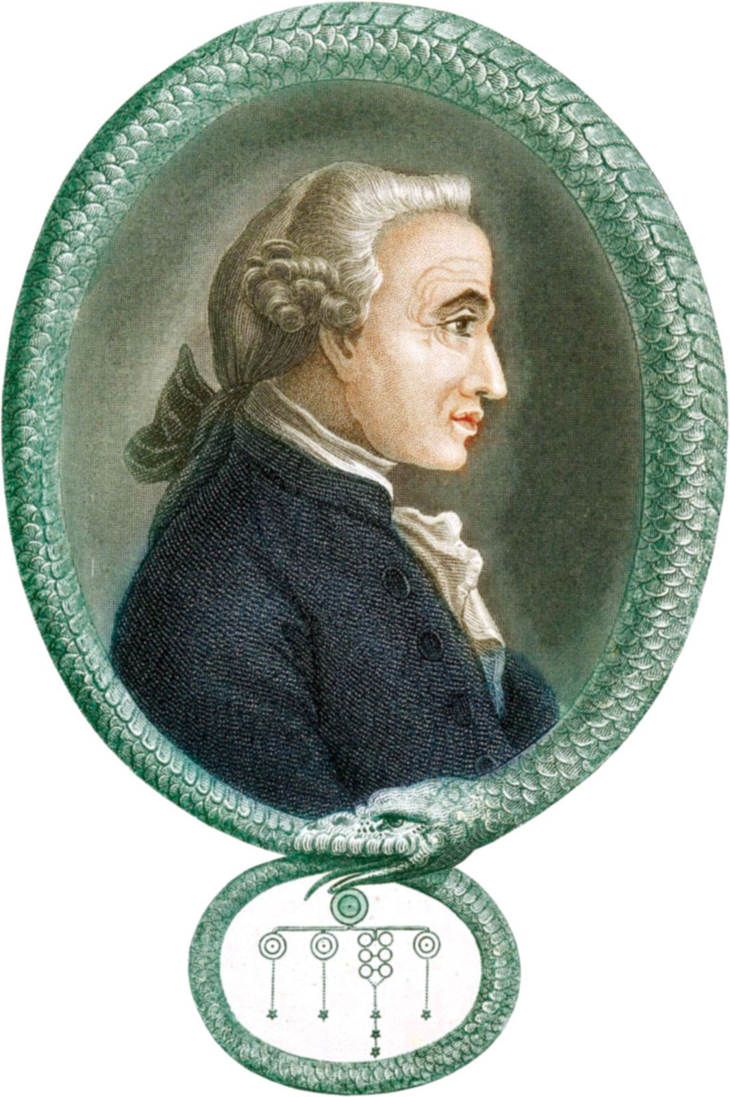
Ethical Principles: Immanuel Kant
Immanuel Kant’s Categorical Imperatives
“One should act only on maxims that they could rationally will to become a universal law for all people.”
Hypothetical Imperatives apply to those who wish to attain certain ends.
“I must not lie, because I’ll be punished if caught”
Categorical Imperatives are commands that must be obeyed in all circumstances and are justified as ends in themselves.
“I must not lie. (Period)”

Slide 28
Ethical Principles: Immanuel Kant
Suppose a rule: One is allowed to lie, if it is to benefit oneself.
If everyone followed this rule, the social construct of trust would be eroded, and the rule can’t be considered universal.
Kant argues that morality must rest on universal rules, valid as ends in themselves.
Raises some questions:
Should we follow rules that ignore the consequences of our actions?
If lying is categorically immoral, is it immoral to lie even if we do so to protect a victim of violent crime?

Slide 29
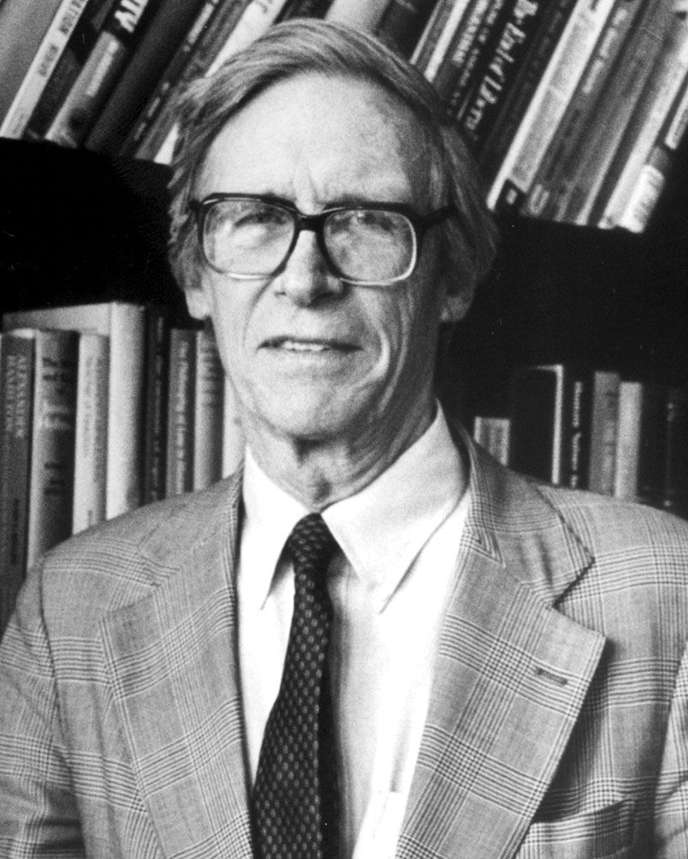
Ethical Principles: John Rawls
John Rawls and the Veil of Ignorance (Original Position).
“A just society is a society that if you knew everything about it, you’d be willing to enter it in a random place.”
Thought experiment: Place people in the original position behind a veil of ignorance, meaning they are unaware of:
Their class or social status
Their natural assets, such as intelligence or strength
Their personal beliefs or preferences
If the designers of this society are willing to participate as players, it must be a just society.

Slide 30
Ethical Principles: Other Examples
Slippery Slope Rule
If an action cannot be taken repeatedly, it should not be taken at all.
e.g. Allowing minor privacy intrusions could lead to widespread surveillance if repeated.
Risk Aversion Principle
Take the action that produces the least harm or the least potential cost.
e.g. Choosing more secure but slower software updates to minimize the risk of catastrophic breaches.
No-Free-Lunch Rule
Assume everything of value is owned by someone unless explicitly stated otherwise.
e.g. Using images, music, or software without proper licensing violates intellectual property rights.
As the appearance of unethical behavior itself can be damaging, managers must closely examine any actions that do not pass these ethical principles.

Slide 31
Professional Codes of Conduct / Ethics
Professionals have special rights and obligations due to specialized knowledge and public trust.
Professional associations often create Codes of Conduct:
To Set entrance qualifications and measure competence.
To Establish shared ethical standards.
To promote accountability and self-regulation.
Some professional organizations set a Code of Ethics.
In general, code of conducts govern the rules and behaviors in specific conducts.
Meanwhile, code of ethics focus on the values and guiding ideals of professionals.
In practice, the lines are blurred and often used interchangeably.

Slide 32
Governance Codes
Beyond profession-wide codes of ethics, organizations also adopt governance codes to guide internal behavior.
Governance Codes are internal frameworks of policies, guidelines, and technical guardrails.
Ensure consistent ethical decision-making and align with values, compliance, and risk management.
Example: Accenture’s Responsible AI Program
Accenture has implemented a Responsible AI program to operationalize ethics.
Based on core principles of “Human by design”, Fairness, Transparency, Safety, Accountability, Compliance, Sustainability.
Example: Responsible AI Institute
Responsible AI Institute offers “Industry-agnostic, plug-and-play” policy templates.
Major players such as AWS, BCG, ATB Financial, Shell are members.

Slide 33
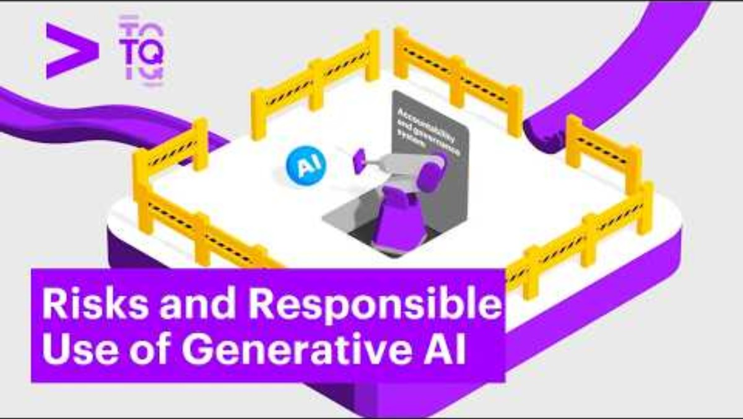
Accenture (2025, March 28). Risks and Responsible Use of Generative AI [Video]. YouTube. https://youtu.be/-n1eQXLZnXc?si=Mrml5p76V6z7izyl

Slide 34
Information Rights

Slide 35
Information Rights in the Digital Age
In the digital era, ethical dilemmas often center on the collection and use of personal information.
Information Rights refer to the rights that individuals and organizations have regarding information that pertains to them.
Privacy is the claim to be left alone, free from surveillance or interference by others, including employers and the state.
Advances in IT have made it cheap, profitable, and highly effective to invade individual privacy.

Slide 36
Legal Protections in the U.S.
In the U.S., privacy protections come from constitutional amendments:
First Amendment: Protects freedom of speech and association.
Fourth Amendment: Guards against unreasonable search and seizure.
Fifth and Fourteenth Amendments: Ensure due process when personal data is involved.
Federal laws also guarantee privacy protection:
Privacy Act (1974): Lets people see, correct, and limit how federal agencies use their personal data.
HIPAA: Protects medical records; gives patients privacy and access rights.
Gramm-Leach-Bliley (1999): Requires banks to safeguard financial data and explain sharing practices.
…and much more (See Table 4.3)
U.S. privacy law is piecemeal and sector-specific, not a single unified framework, so to fill these gaps, a broader set of guiding principles was developed.

Slide 37
Fair Information Practices
Fair Information Practices (FIP) were first proposed in 1973 as a set of principles to govern how organizations collect and use personal information.
FIP emphasizes a mutual responsibility: individuals share data for transactions, and organizations must respect ongoing rights to that information.
The FTC expanded FIP in 1998 and 2010 to address online privacy, requiring transparency, user consent, and stronger protections against misuse.
For example, COPPA requires websites and apps to obtain parental consent before collecting data on children under 13.
While the U.S. has relied on FIP, the EU took a stronger step.

Slide 38
Legal Protections in the EU
The EU’s General Data Protection Regulation (GDPR) is the most comprehensive privacy law to date.
It applies worldwide to any organization that processes the personal data of EU citizens, regardless of location.
GDPR strengthens individual rights by guaranteeing access to personal information, the right to be forgotten, and the right to data portability.
Organizations must gain explicit opt-in consent, appoint data protection officers, and report breaches within 72 hours.
Penalties can reach $20 million or 4% of global revenue, making GDPR a powerful enforcement tool.

Slide 39

Parks and Recreation (2017, November 2). Parks and Recreation | Ron vs. Online Privacy (Episode Highlight) [Video]. YouTube https://youtu.be/8xn1rO1oQmk?si=aIG2hKThMKFYd15F

Slide 40
Challenges Posed by the Internet
But even with laws in place, the Internet itself creates major privacy challenges.
The Internet enables companies to track users’ searches, browsing history, purchases, and mobile app usage.
Cookies are one of the most common tools:
First-party cookies enhance the user experience
Third-party cookies track users across multiple sites for advertising purposes.
Web beacons, spyware, and adware extend surveillance by collecting detailed data.
Companies argue that such tracking enables free content and more relevant advertising, but public surveys show widespread distrust and a sense of lost control.

Slide 41
Challenges Posed by AI
Artificial intelligence magnifies existing privacy concerns by requiring massive datasets for training and decision-making.
Tech companies have been accused of scraping personal data from the Internet without user consent to train generative AI models.
Industries such as healthcare and finance face added risks when sensitive data is used in AI systems.
Facial recognition databases, often built without consent, have sparked lawsuits under state biometric privacy laws.
Can technology itself help restore privacy, or must we rely on law and ethics?

Slide 42
Technological Solutions
Privacy-enhancing technologies (PETs) aim to give users more control over their data.
e.g. Encryption, VPNs, ad blockers, cookie controls, and browser privacy settings.
Many firms now offer privacy dashboards and consent managers to increase transparency.
However, most tools require users to take proactive steps, and they do not provide complete protection.
Effective privacy protection requires a combination of technology, law, and ethical organizational practices.
Privacy challenges remind us why information rights are a central moral dimension of the Information Age.

Slide 43
Intellectual Property Rights

Slide 44

Intellectual Property in the Digital Age
Intellectual Property (IP) refers to products of the mind, such as ideas, inventions, and creative works.
Modern information technology makes IP protection more difficult because digital content can be copied, transmitted, and altered with ease.
It is traditionally protected through four legal traditions:
Copyright
Patents
Trademarks
Trade Secrets

Slide 45
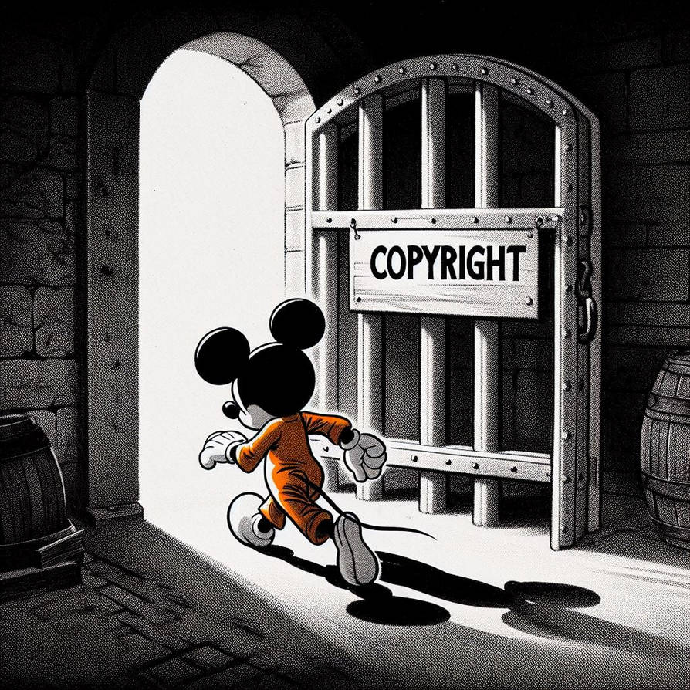
Copyright
Copyright protects the creators of literary, artistic, musical, and software works.
Copyright generally lasts for the life of the author plus 70 years, or 95 years for works owned by corporations.
Copyright law protects the expression of ideas but not the underlying ideas themselves.
Example: Steamboat Willie (1928)
The copyright for the film Steamboat Willie expired, making the first version of Mickey Mouse available in the public domain.

Slide 46
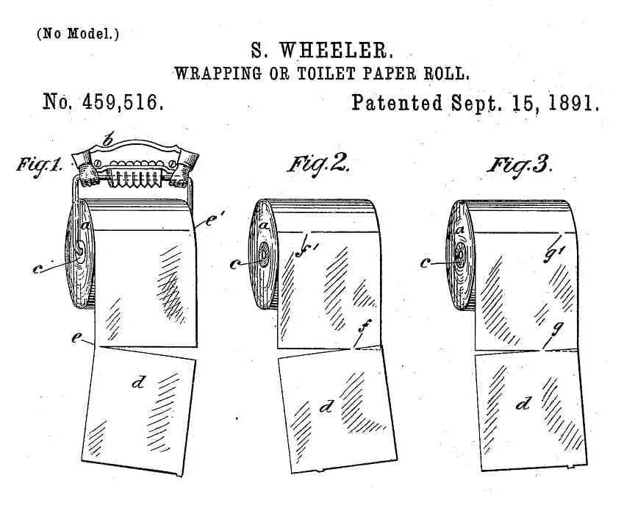
Patent
A patent grants the owner an exclusive monopoly on an invention for 20 years.
To qualify, an invention must demonstrate novelty, originality, and non-obviousness.
Patents protect the underlying concepts of software or machines, not just their expression.

Slide 47
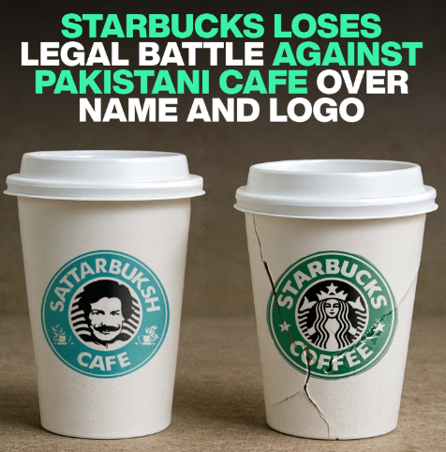
Trademarks
Trademarks protect distinctive marks, logos, or symbols used to identify products in the marketplace.
Trademark law prevents consumer confusion and protects the investments that firms make in building their brands.
Example:
Starbucks lost a legal battle against a Pakistani café using a similar name and logo (“Sattar Buksh”)

Slide 48
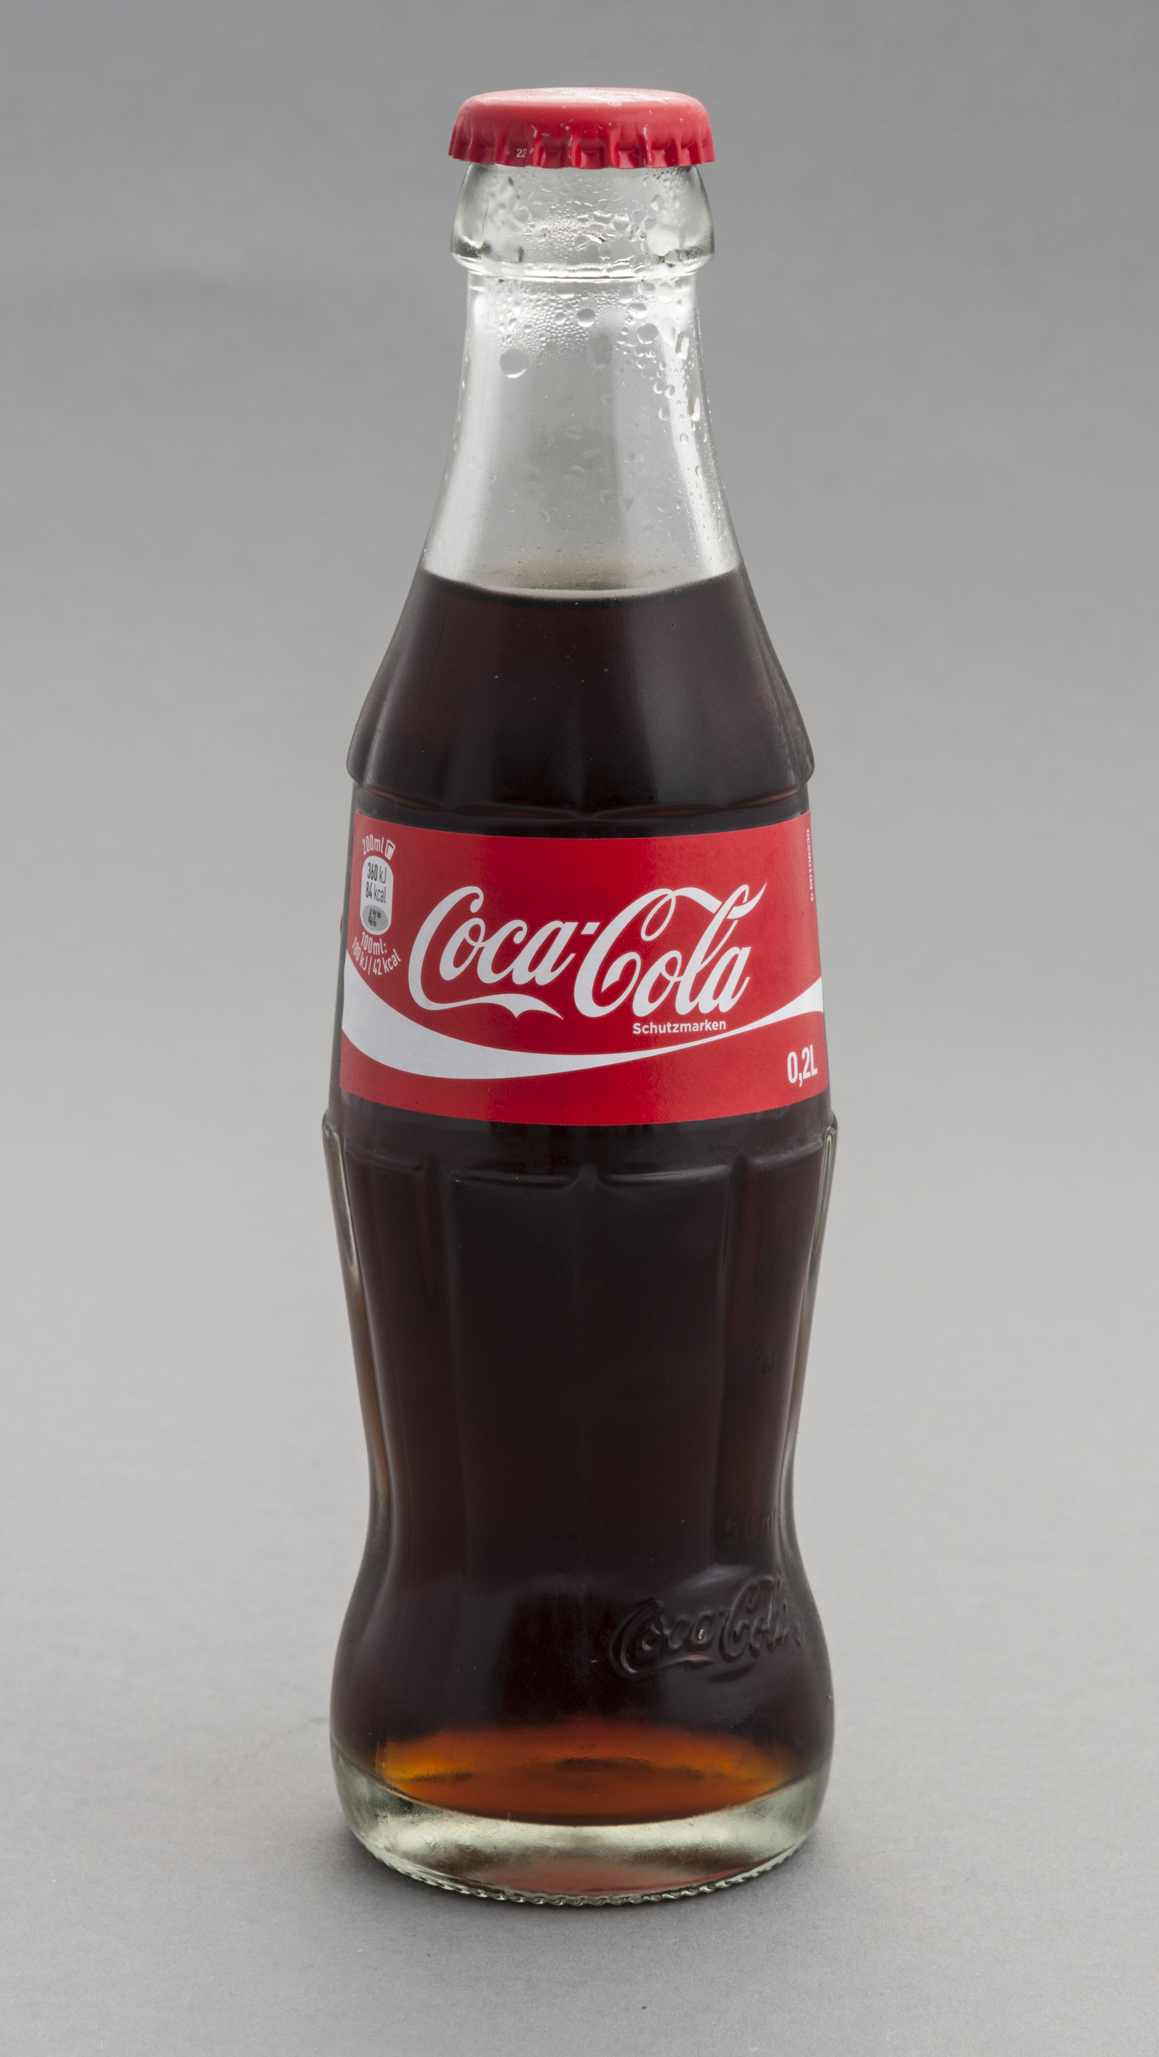
Trade Secrets
Trade secrets include formulas, processes, devices, or compilations of data used for business purposes.
Protection depends on keeping the information confidential through nondisclosure agreements and secure practices.
Trade secret law protects the actual ideas behind a work, not just the way they are expressed.
However, once a trade secret enters the public domain, protection is lost.
Example:
Coca-Cola’s recipe was never patented and kept a trade secret.

Slide 49

Half as Interesting (2022, June 2). How Coca Cola (Actually) Keeps Its Secret Recipe Secret [Video]. YouTube. https://youtu.be/7ug8tHiR98w?si=fsLhCXQiX16ui7g1

Slide 50
Challenges of Digital Networks
Digital media can be copied, transmitted, and altered with almost no cost or effort.
The Internet has made piracy widespread, with 230 billion visits to piracy websites in 2023, an increase of 6.7 percent from 2022.
Early peer-to-peer platforms such as Napster, Grokster, and Kazaa disrupted the music and film industries by enabling illegal file sharing.
Legal and technical solutions such as the DMCA, iTunes, and streaming platforms like Spotify and Kindle have reduced piracy but not eliminated it.

Slide 51
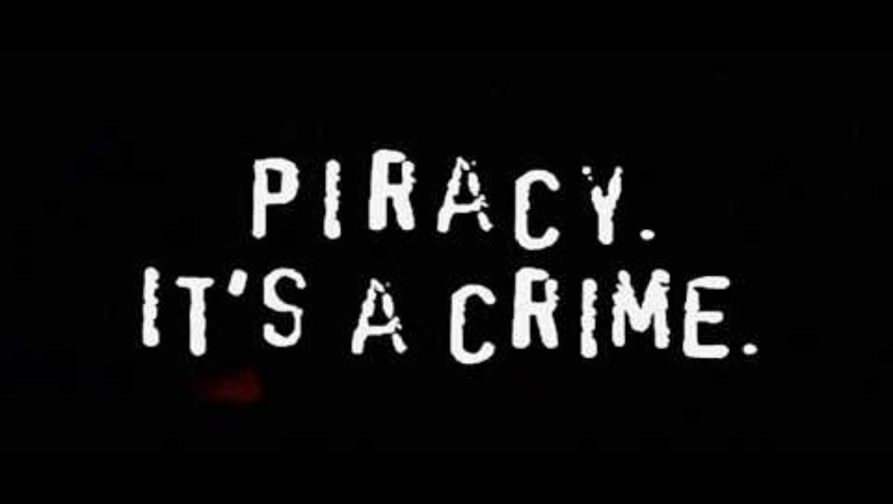
avril134 (2006, May 4). Piracy. It’s a Crime [Video]. YouTube. https://youtu.be/K_vHwfDNGdg?si=aIiSKBxvEFgJTh8H

Slide 52
AI and Intellectual Property
AI has raised copyright concerns because companies such as OpenAI, Microsoft, and Meta have trained models on copyrighted works without permission.
Patent law now allows inventions created with AI assistance, but only if humans make a significant contribution.
AI-generated outputs may resemble existing logos or designs, which can create trademark disputes and consumer confusion.
Trade secrets are at risk because employees sometimes share sensitive company data with public AI tools, while firms themselves increasingly hide algorithms as proprietary “black boxes.”

Slide 53
System Quality

Slide 54
System Quality Issues
In earlier sections we examined information rights and property rights; now we turn to system quality, accountability, and quality of life as key moral dimensions.
Because businesses and society depend on reliable information systems, we must ask: what level of system quality is acceptable?
System failures raise ethical questions about accountability, liability, and responsibility when harm occurs.
Example: AWS Outage of 2020
These failures disrupted many everyday functions of society.
Such outages highlight society’s growing dependence on a small group of cloud providers.
These cases raise the question of whether such disruptions should be considered acceptable risks or unacceptable failures of system quality.

Slide 55

CNBC Television (2020, November 25). Amazon Web Services experiencing widespread outage [Video]. YouTube. https://youtu.be/II4ogZUdd6o?si=Ube-fiFF26Q6gNKp

Slide 56
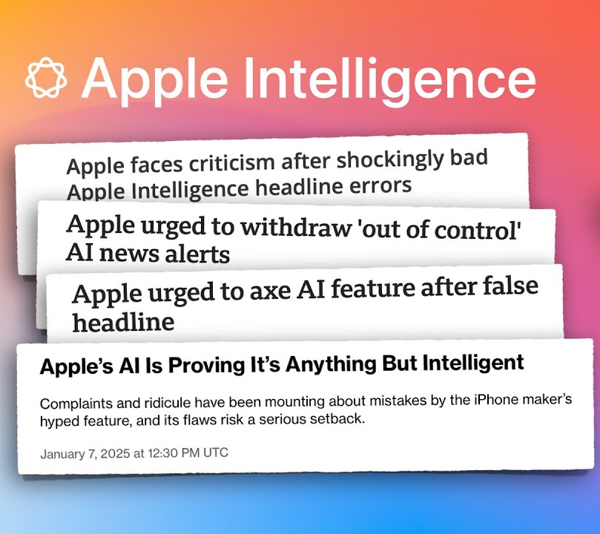
The Debate on “Acceptable” Quality
Managers must balance cost, time, and feasibility when deciding to release software.
Firms knowingly release products with bugs because fixing every error would make products too expensive or delay them indefinitely.
The Ethical Dilemma: Should companies delay, withdraw, or ship imperfect products knowing the risks?
Example: Apple Intelligence Rollout (2024)
Apple outsourced many generative AI functions to ChatGPT because its own system wasn’t ready.

Slide 57
Three Major Sources of Failure
What responsibilities do managers bear when perfection is technologically impossible?
Perfection is not attainable due to three major reasons:
Software Bugs and Errors: Inevitable given software complexity.
Hardware or Facility Failures: Often caused by natural disasters or technical breakdowns.
Poor Input Data Quality: The most common and persistent source of business system problems.
Among these causes, poor data quality deserves special attention, since it quietly undermines performance more often than catastrophic failures.

Slide 58
Accountability and Control

Slide 59
Accountability
The use of information technology sometimes results in harm, raising the question of who should be held accountable.
Accountability refers to identifying who is responsible for harm caused by defective or misused systems.
This issue ties directly to our discussion of system quality: if perfection is impossible, then responsibility for harm becomes even more important.

Slide 60
Software and Internet Liability Issues
Poorly designed or unpatched software can cause significant harm, with reports suggesting up to 60% of breaches stem from unpatched vulnerabilities.
Unlike physical products, software is often not legally treated as a “product,” which makes liability cases difficult to pursue.
Vendors often use end-user license agreements (EULAs) to shield themselves from liability, leaving users with little legal recourse.
Example: Boeing admitted full responsibility for the 2019 737 Max crash, caused by faulty software integrated into the aircraft system.
These challenges become even more complex with AI systems, where decision-making is often opaque.

Slide 61
AI Liability Issues
AI often functions as a “black box,” making it hard to assign responsibility when harm occurs.
The EU AI Act (2024) and the revised EU Product Liability Directive make AI providers legally accountable, treating them as manufacturers.
This framework shifts the burden of proof toward companies, protecting consumers in cases where AI systems are too complex to audit.
Beyond liability, accountability also extends to intentional misuse of systems, which falls under computer crime and abuse.

Slide 62
Computer Crime and Abuse
Computer crime refers to illegal acts using or targeting computer systems, such as malware, phishing, and denial-of-service attacks.
Computer abuse covers unethical but not always illegal acts, such as spamming.
Spam now accounts for around 45% of global email traffic, often originating from botnets and offshore servers.
U.S. regulation (CAN-SPAM Act) requires transparency but does not ban spam, unlike stricter EU laws.
These debates about liability and computer crime lead us to a broader concern on “how do information systems impact the overall quality of life for individuals and society?”

Slide 63
Quality of Life

Slide 64

Quality of Life Issues
Beyond rights, property, and accountability, IS also affect the overall quality of life.
These effects may not always violate individual rights, but they can undermine culture, society, and personal well-being.
Key question to be asked is “If both benefits and harms exist, who is responsible for the negative consequences?”
We begin with the concentration of economic and political power in Big Tech.

Slide 65
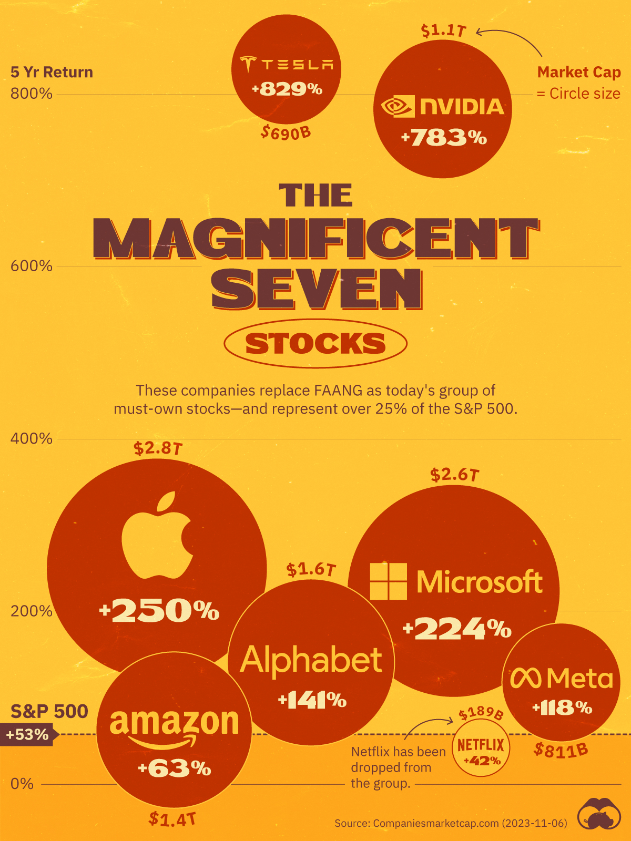
Big Tech: Concentrating Power
A few firms dominate key digital markets, and their dominance translates into political influence.
Antitrust enforcement is reemerging:
In 2024, Google was found guilty of illegally maintaining a monopoly in Internet search.
Europe’s Digital Markets Act (DMA, 2024) seeks to limit gatekeeper power across platforms.
Concentration of power highlights inequality at the market level. But inequality also emerges at the individual level through the digital divide.

Slide 66
The Digital Divide
Access to computers, the internet, and digital skills remains uneven across income, racial, and geographic lines.
Higher-income children use the internet for education, while lower-income children are more likely to use it for entertainment (“time-wasting gap”).
Left unaddressed, the digital divide could create a society of “information haves” and “have-nots.”
AI systems may reinforce inequalities when trained on biased data, leading to discrimination in policing, lending, and hiring.
Just as access is unequal, so is the distribution of jobs, as automation and AI reshape employment.

Slide 67
Jobs and Automation
Information systems and automation have eliminated millions of jobs, even while creating new opportunities.
AI is expected to reduce hiring for roles like customer service, while creating demand in technical and fast-growth industries.
Economists disagree on whether technology will ultimately create more jobs than it destroys.
The impact of AI on the workforce is uncertain, but its influence is undeniable.
Rapid change in markets and work also pressures organizations and individuals to adapt quickly.

Slide 68
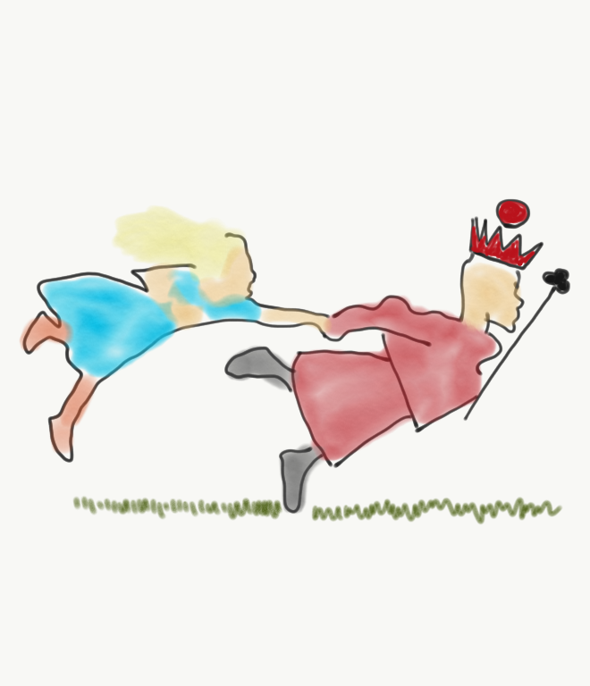
Pace of Change
Global competition and digital markets have reduced the time available for firms to adjust.
Just-in-time economies can produce just-in-time jobs, workplaces, and even families.
Gig economy platforms like Uber provide flexible work but often without benefits or long-term security.
Beyond jobs and markets, quality of life is also shaped by blurred boundaries between work, family, and leisure.

Slide 69
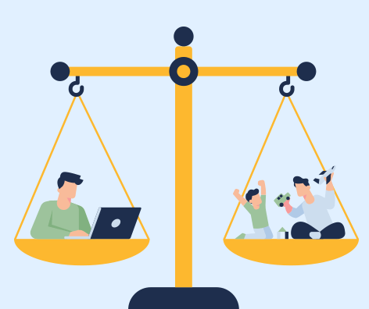
Maintaining Boundaries
Remote work, mobile computing, and “always-on” devices blur the lines between work and personal life.
Family, leisure, and private reflection time are increasingly encroached upon by work.
Social media and mobile apps can disrupt relationships.
These social stresses are compounded by physical, mental, and cognitive health risks.

Slide 70
Health Risks
Physical Risks: Repetitive Stress Injury (RSI), carpal tunnel syndrome, back and neck pain, and Computer Vision Syndrome (CVS).
Mental Health Concerns: Screen time, online comparisons, cyberbullying, and social media addiction.
Cognitive Concerns: reliance on search engines and AI tools may reduce deep thinking and problem-solving skills.
As technology continues to evolve into areas like AI and the metaverse, these quality-of-life challenges will only intensify.

Slide 71
Recap of Chapter 4

Slide 72
Recap of Chapter 4
Describe IT/IS-related ethical, social, and political issues.
Describe principles for ethical conduct.
Discuss information rights and privacy issues.
Discuss intellectual property issues.
Discuss system quality issues.
Discuss accountability and control issues.
Discuss quality of life issues.

